Slide 1

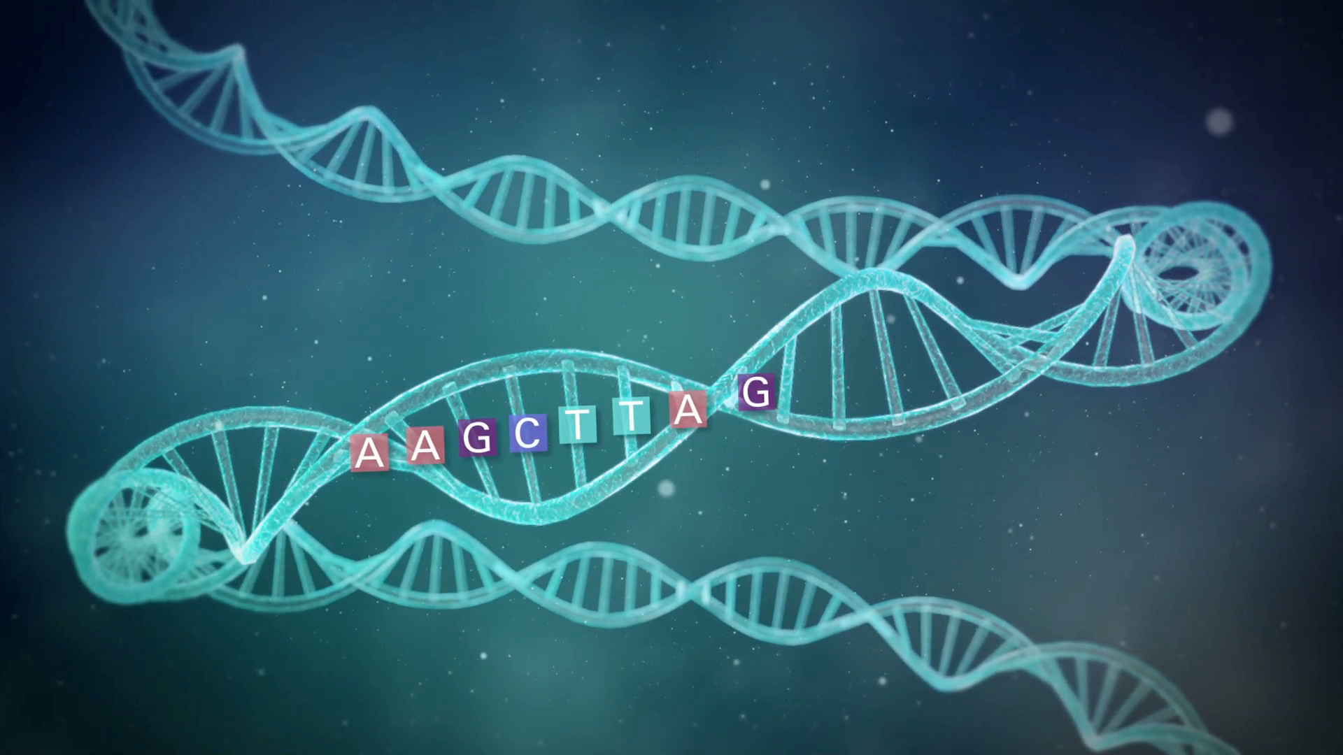
Introduction to Computer Science
Shimon Schocken
IDC Herzliya
Lecture 4-1
Arrays, Part I
Notes:
1

Slide 2
Array processing example: DNA
0
1
2
3
4
5
6
7
8
9
…
dna array:
A
C
A
C
G
G
T
C
G
T
…
// Normally, we’ll read the DNA array data from a file.
// For testing purposes, we often use a small example:
char[] dna = {'A','C','A','C','G','G','T','C','G','T'};
// Which base appears in location 3?
System.out.println(dna[3]);
// Mutation
dna[1] = 'G';
// Mutation: switches bases 3 and 4
char temp = dna[4];
dna[4] = dna[3];
dna[3] = temp;
// Prints the array
for (int i = 0; i < dna.length; i++) {
System.out.print(dna[i] + " ");
}
What is the difference between an array of char values and a String?
Internally, they are handled exactly the same, as reference variables
But:
Strings are immutable (cannot be changed)
Arrays are mutable.
Notes:
2

Slide 3
What happened
Did not have time to teach the CDF example

Slide 4
Array variables
RAM
10
arr
20
10
...
. . .
...
RAM
RAM
10
10
arr
0
0
...
arr
v₀
v₁
v₂
...
. . .
. . .
...
...

Slide 5
How Java handles strings
high-level abstraction
low-level implementation
...
int n = 100;
String s1 = "abc";
String s1 = "abc";
s1 = { + 'z'; // 'z' is cast as string
s = s + 'e’; // 'z' is cast as string
System.out.println(s); // zehuze
s = s.replace('z', 'v');
System.out.println(s); // vehuve
...
RAM (before)
...
n
10
100
s1
abc
s2
abc
...
RAM (after)
...
10
n
100
s1
axc
s2
abc
...
axc

